Slide 1
The State of Azure Infrastructure as Code
Sam Cogan

Slide 2




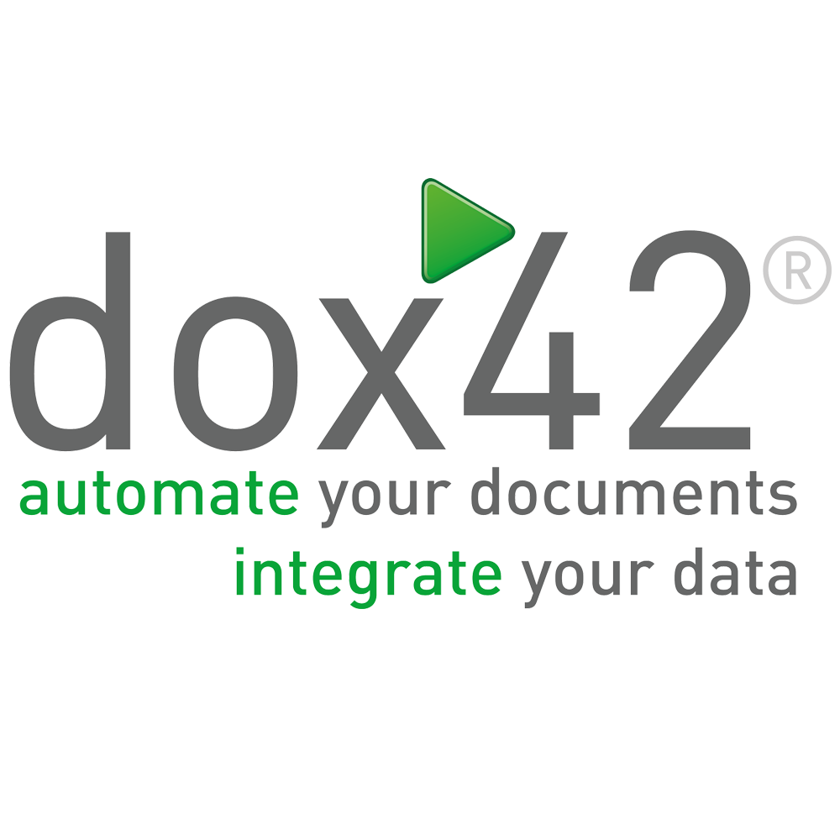

Thank You to our Sponsors…
Event Sponsor
Platinum Sponsors

Slide 3

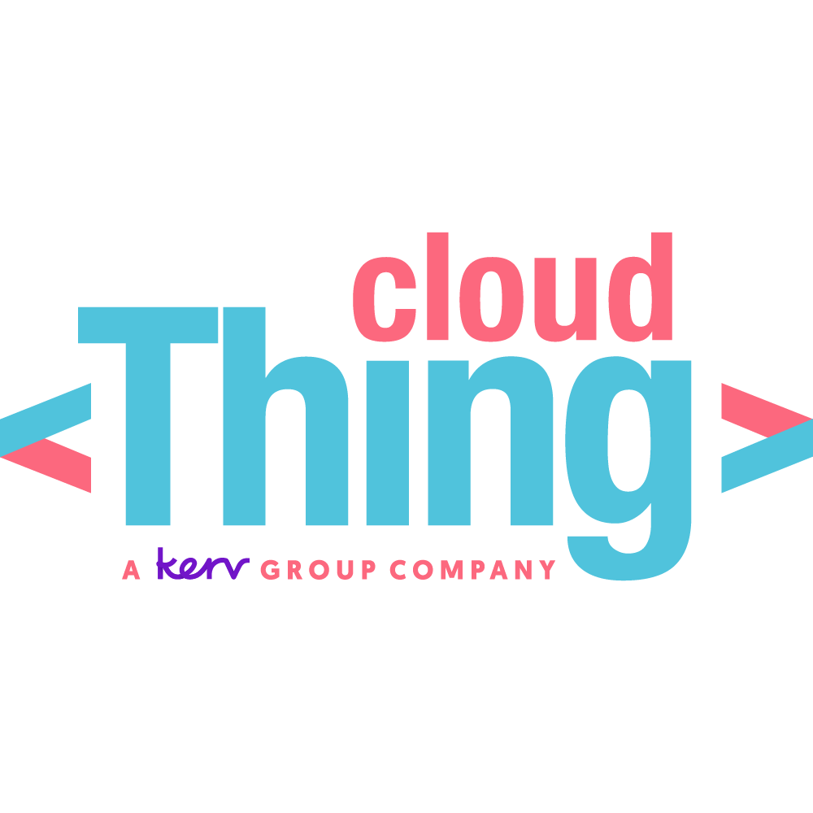
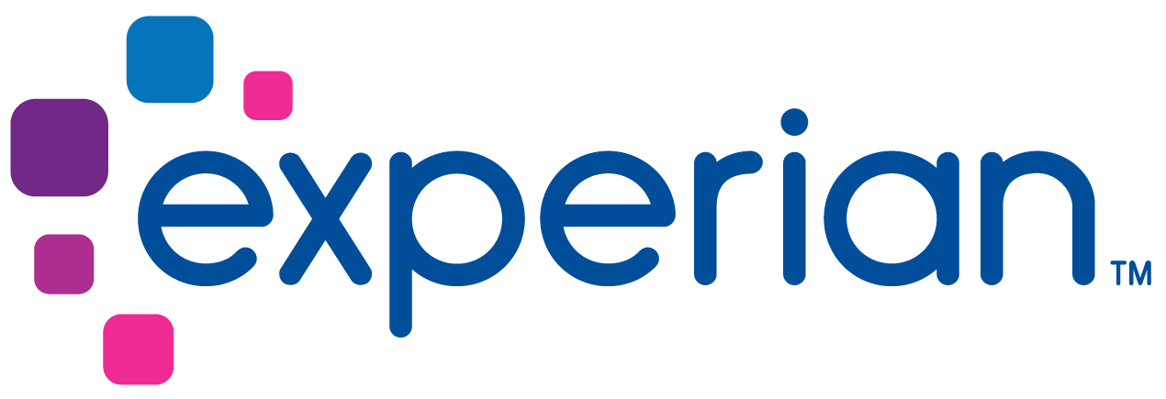
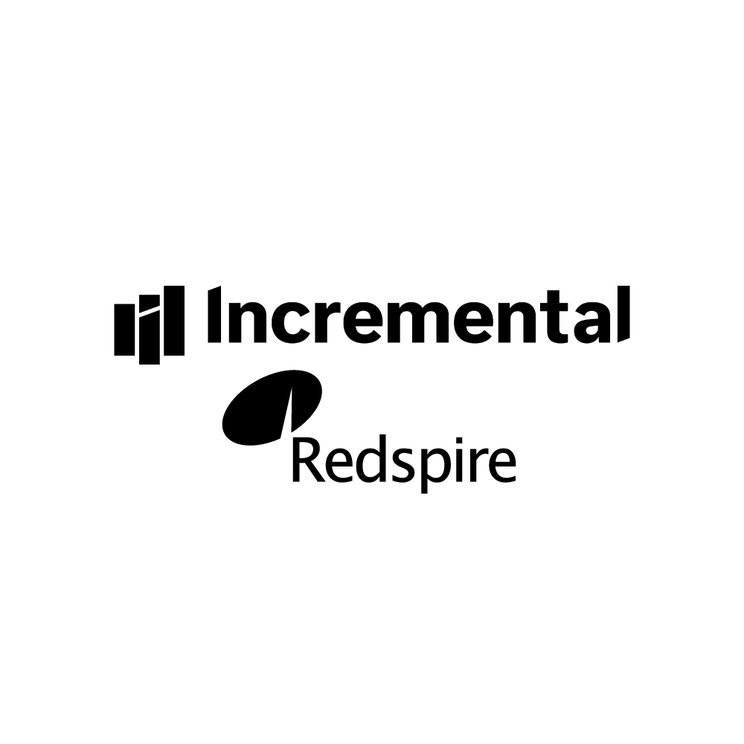




Thank You to our Sponsors…
Gold Sponsors
Data Quality
Event Lunch
Accessibility
Data Analytics

Slide 4





Sam Cogan
Solution Architect
WTW
Microsoft Azure MVP
Designs Cloud Native platforms for complex applications
Infrastructure as Code evangelist
samcogan.com
@samcogan
github.com/sam-cogan
youtube.com/samcogan

Slide 5
What is Infrastructure as Code
Declarative
Drift Correction
Idempotent
Modular
Immutable
Reusable

Slide 6
Benefits of Infrastructure as Code
Consistency
1
Speed
2
Collaboration
3
Accountability
4
Scalability
5
Versioning
6
Testing
7
Documentation
8

Slide 7






Options in 2022
PowerShell/CLI
Terraform
ARM Templates
Pulumi
Bicep
Farmer

Slide 8
CLI/PowerShell
Not really Infrastructure as Code
Not Idempotent
Not declarative
May have its place where all else fails
Consider using an escape hatch in your IaC language first

Slide 9
Azure Resource Manager Templates
Microsoft native language for IaC on Azure
Supported directly by Microsoft
JSON based with a custom DSL
Stateless
Closed Source

Slide 10

Bicep
New Microsoft higher level abstraction for Iac on Azure
Supported directly by Microsoft
Custom DSL
Uses ARM templates under the hood
Stateless
Open Source
Auto-Generated

Slide 11
Terraform
Third party multi-platform IaC solution
Supported by Hashicorp or community
Probably the largest user base of all IaC tools
Custom DSL (HCL)
Stateful
Open Source with enterprise version
Hand Crafted

Slide 12
Pulumi
Third party multi-platform IaC solution
Support by Pulumi or community
Not a DSL, uses real languages such as Python, Go, TypeScript and .net
Stateful
Open Source with enterprise version
Auto-Generated (Azure Native)

Slide 13
Farmer
Third party Azure only IaC solution
Supported by Compositional IT or community
DSL based on F# language
Compiles to ARM templates under the hood
Stateless
Open Source

Slide 14
Which to Choose?

Slide 15
Multi-Platform Support

Slide 16
Microsoft Support & Updates

Slide 17
Programming Language Support

Slide 18
Stateful

Slide 19
Stateless

Slide 20
Auto-Generated

Slide 21
Hand Crafted

Slide 22
Comparison
 | ARM | Bicep | Terraform | Pulumi | Farmer
Languages | JSON | Custom DSL | Custom DSL (HCL) | Node JS (TS, JS), Python, .NET Core, GO, YAML | F#
Speed Of Update | Fastest | Fastest | Slower | Fast | Fast
Multi Cloud | No | No | Yes | Yes | No
Stateful | No | No | Yes | Yes | No
Open Source | No | Yes | Yes | Yes | Yes
Support | Microsoft | Microsoft | Community/Paid | Community/Paid | Community/Paid
Generation | Auto-Generate | Auto-Generated | Hand-Crafted | Auto-Generated | Auto-Generated with helpers
Additional Features | Policy (separate service) | Policy (separate service) | Cloud State Policy & Governance Module Repository Web Portal Cost Estimation | Cloud State Policy & Governance Web Portal

Slide 23
Real-World Scenarios
Getting started
Developer Adoption
End to End Kubernetes Deployment
Automation Platform
Escape Hatches

Slide 24
Changing Language
Are you unhappy with your current choice?
How much work is it to transition?
Can you transition gradually?
Does it add value?

Slide 25
Thank You to our Sponsors…
Event Sponsor
Platinum Sponsors

Slide 26
Thank You to our Sponsors…
Gold Sponsors
Data Quality
Event Lunch
Accessibility
Data Analytics

